Slide 1
Car Features and MSRP
Thinkful Supervised Learning Capstone
Yeu-Fann Stafford

Slide 2
Introduction
One of the most significant purchases in many people's lives is a car. Not only is it one of the most expensive purchases (after a house), it is one that is often used daily.
Whether buying a car new or used, a savvy consumer will do some research to determine the best fit, from both a feature and value standpoint.
Conversely, it is important for car manufacturers to understand what consumers value to determine a fair Manufacturer Suggested Retail Price (MSRP).
This study will investigate the relationship between a car's features and its MSRP.

Slide 3
Research Plan
Due to the number of features remaining and the correlations between some of them, principal component analysis (PCA) was first applied to reduce dimensionality.
A combination of GridSearchCV and model-specific cross validation functions from the scikit-learn toolbox were used to determine optimal hyper-parameter sets.
Once optimal hyper-parameter sets were found, cross validation was performed on the best estimators for each model comparing the training set, test set and full set of data to compare R² scores across folds.
Models were run on a sedan-only subset to determine whether body style affects model performance.
The K-Nearest Neighbors model was run on individual body styles. It was chosen as the best performing model.

Slide 4
Data Set
The original data set used was scraped from www.thecarconnection.com and collected by nicolas-gervais in the r/datasets subreddit on Reddit available here: https://www.reddit.com/r/datasets/comments/b6rcwv/i_scraped_32000_cars_including_the_price_and_115/.
This set includes all vehicle makes and models available without adjustment for number of vehicles sold so is not necessarily representative of the vehicles actually found on the road but rather this theoretical set.
The data set used for these models included 14,300 rows and 42 features (3 categorical, 11 boolean, 28 continuous).

Slide 5
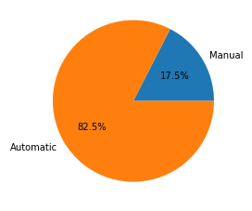
Categorical Variables: Transmission
A dummy variable was created to denote whether vehicles were manual transmission.
Only vehicles that were explicitly labeled as manual were flagged. Some vehicles had ambiguous names that were not specifically manual or automatic and these were assumed to be automatic.

Slide 6
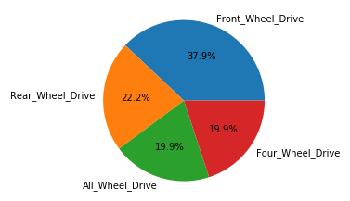
Categorical Variables: Drivetrain
Separate dummy variables were created to denote different drivetrain types:

Slide 7
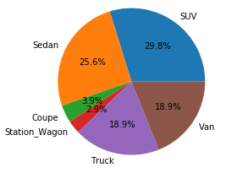
Categorical Variables: Body Style
Separate dummy variables were created to denote different vehicle body styles:
Some other body styles such as convertibles were originally present but ended up excluded after data cleaning.

Slide 8
Boolean Variables: Safety Features
Vehicle safety is an important factor when selecting a vehicle but no safety data were included in this data set.
In lieu of safety data, inclusion of various safety features was used instead:
ABS Brakes
Air Bags
Front
Side
Head
Traction Control
Fog Lamps
Parking Aid
Back-up Camera

Slide 9
Continuous Variables
The continuous variables were drawn from four categories:
Dimensions
Passenger capacity
Number of doors
Height
Wheelbase
Interior
Hip room
Leg room
Head room
Fuel Efficiency
Tank capacity
Estimated Fuel Economy (City / Highway)
Warranty Length
Basic
Corrosion
Drivetrain

Slide 10
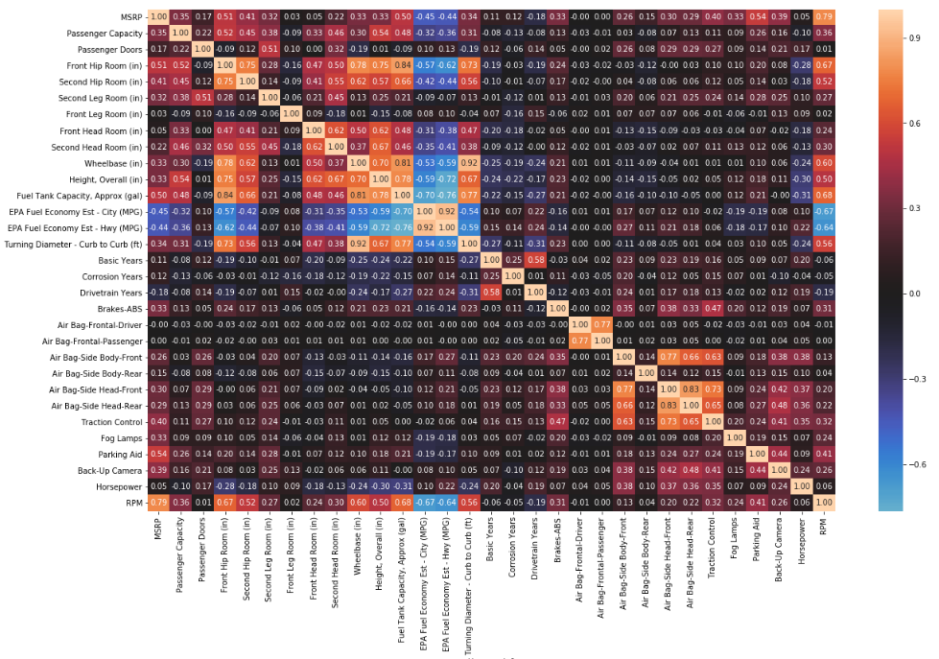
Correlation Heatmap
There are some significant correlations so these will need to be dealt with later.

Slide 11
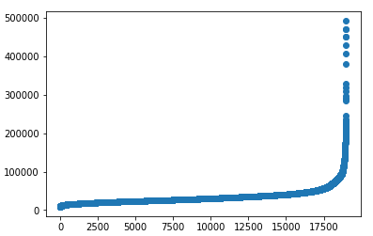
Data Cleaning
All rows containing missing data were removed. Without a thorough classification of each vehicle, it would be difficult to properly impute many of these features.
The top 5% of vehicles by MSRP (>$77k) were removed. Most of these are top end brands or limited edition vehicles. As such, there may be some built in ‘premium’ not encompassed in other variables. A logarithmic conversion might be able to smooth the curve but not account for such a premium.

Slide 12
Models Used
The following supervised learning models were used:
K-Nearest Neighbor
Decision Tree
Random Forest
Ordinary Least Squares Regression
Ridge Regression
Lasso Regression
Linear Support Vector Regression
Radial Basis Function Support Vector Regression
Gradient Boosting Regression

Slide 13
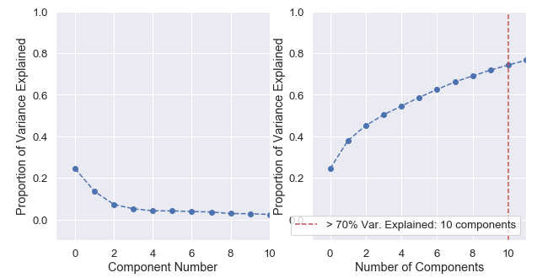
Principal Component Analysis
Principal Component Analysis was applied to the data to reduce dimensionality from the initial 42 features.
The amount of variance explained by the first two components is about 45% with small incremental increases for each additional component. Using the first ten components accounts for about 70% of variance, with all components explaining at least 2.5% of variance.

Slide 14
Principal Component Analysis
To verify using a ten-component PCA was sufficient, a K-Nearest Neighbors model was run using first the full data set and then the transformed data set.
KNN hyper-parameters were optimized by GridSearchCV.
The R² scores values were computed:
Full set: 0.94114
PCA: 0.94442
Since the R² scores were consistent, PCA was deemed viable.

Slide 15

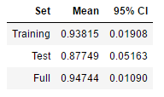
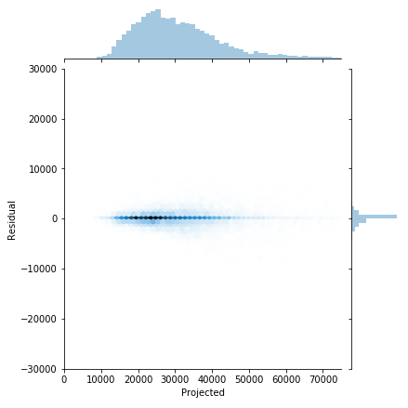
K-Nearest Neighbors
Both the training and full sets have relatively high R² values with a tight range among folds.
The R² of the test set remains high but is lower, suggesting possible overfitting.
The residuals appear tight and normally distributed around 0.

Slide 16

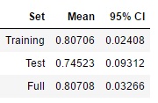
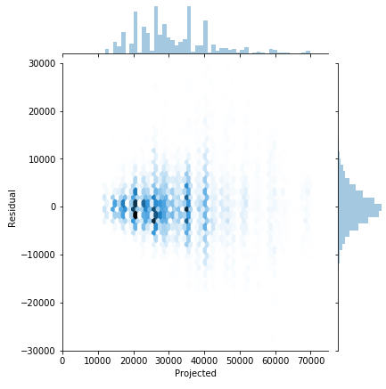
Decision Tree
The Decision Tree model performs worse than the K-Nearest Neighbors model.
There may be some overfitting as the R² for the test set is a little lower than the training set with a wider range as well.
Residuals are wider than K-Nearest Neighbors but still appear to be normal around 0.
There is some 'choppiness' in predicted values but due to the nature of the model this is not surprising since predictions are limited by the original data set.

Slide 17

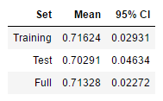
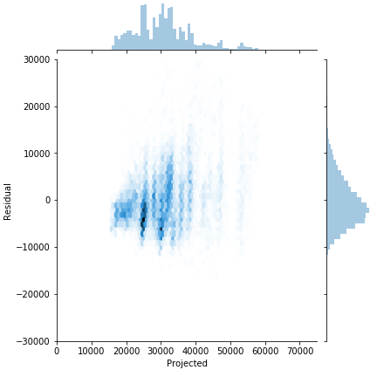
Random Forest
The Random Forest model performs worse than either of the two previous models.
Considering its similarity to the Decision Tree model, this is a bit surprising. However, comparing the optimal hyperparameters chosen by GridSearchCV and looking at the training vs. test results, this may be partly due to overfitting in the Decision Tree model. The Decision Tree model used max_depth = 7 and max_features = 9 compared to only 4 and 6 respectively for the Random Forest model.
There does appear to be a slight positive skew in the residual distribution but this is relatively small.

Slide 18
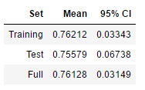
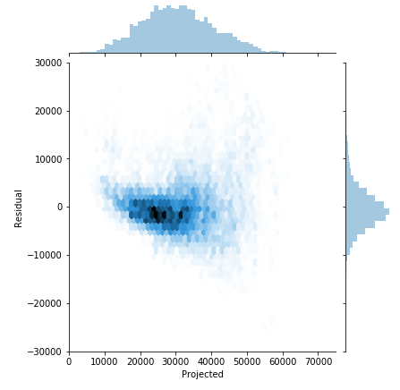
OLS Regression
The OLS model performs slightly better than Random Forest but has a slightly wider range of cross-validation R² scores.
The training and test scores do appear consistent and residuals are normally distributed around 0.

Slide 19

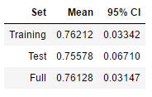
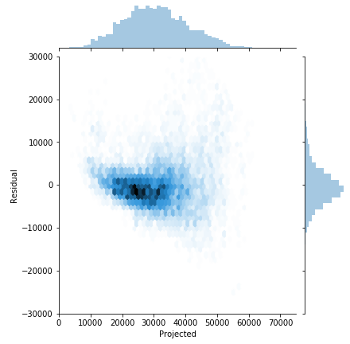
Ridge Regression
The Ridge regression performs similarly to the OLS model, suggesting that the optimal linear regression has minimal L2 regularization.
As for the OLS model, training and test scores appear consistent with residuals normal around 0.

Slide 20

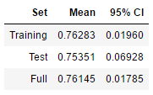

Lasso Regression
The Lasso regression performs similarly to the OLS model and the Ridge regression, suggesting that the optimal linear regression has minimal L1 regularization.
As for the OLS model, training and test scores appear consistent with residuals normal around 0.

Slide 21

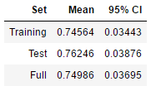
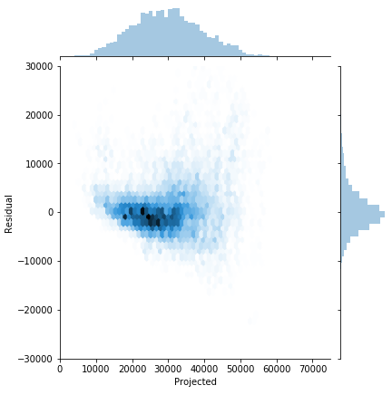
Linear Support Vector Regression
The Linear Support Vector regression performed similarly to the OLS/Ridge/Lasso regressions as well. However, the cross validation scores across the folds were more consistent with the mean R² slightly higher for the test set and the 95% confidence intervals more similar.
Residuals appear normal around 0.

Slide 22

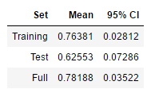
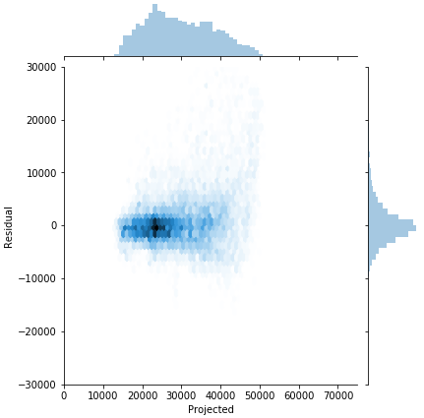
Radial Basis Function Kernel SVR
Although R² scores for the training and full sets are in line with most of the other models, the R² for the test set is considerably lower with wider 95% confidence interval, suggesting that this model is overfit.
Residuals appear normal around 0 and appear more evenly distributed.

Slide 23

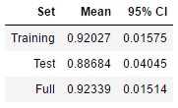
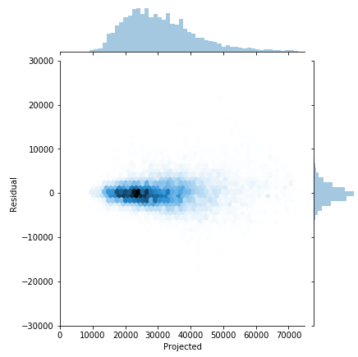
Gradient Boosting Regression
The Gradient Boosting regression performed well, in line with K-Nearest Neighbors for the best model.
R² scores were high with relatively tight 95% confidence intervals.

Slide 24
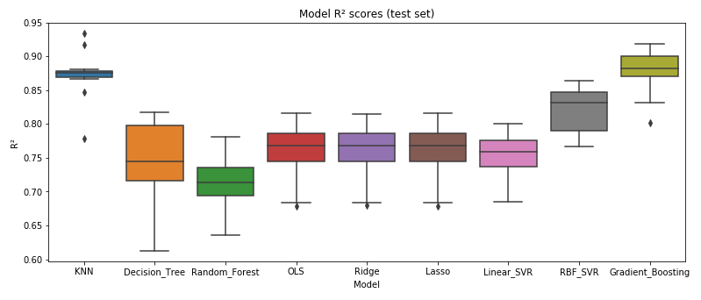
Model Comparison
The K-Nearest Neighbors model and the Gradient Boosting regression performed best.
Random Forest performed worst.
The majority of models had R² scores around 0.75.

Slide 25
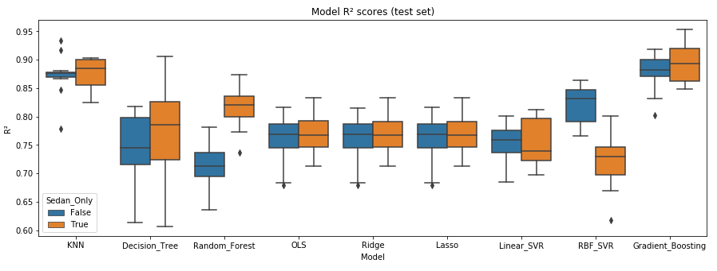
Sedan-Only Results
The R² scores for the models using the sedan-only data set perform similarly to the full data set with a couple of exceptions.
Random Forest went from the worst model in the full data set to the third best in the sedan-only data set.
Conversely, Radial Basis Function Kernel SVR went from the third best model in the full data set to the worst in the sedan-only data set.

Slide 26
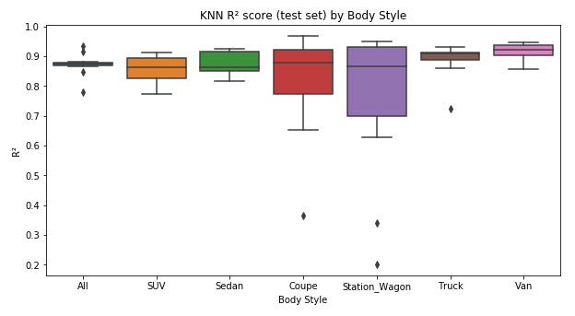
K-Nearest Neighbors by Body Style
Body style did not seem to have a significant impact on the K-Nearest Neighbors model.
Although the 95% confidence intervals for the individual body styles significantly increased, the means all remained over 0.82.
Coupes and station wagons have the widest IQRs with some extreme outliers but account for the smallest number of vehicles at 3.9% and 2.9% of total vehicles, respectively.

Slide 27
Conclusions
The K-Nearest Neighbors model and the Gradient Boosting regression performed best in predicting MSRP. Both had R² scores around 0.90.
Most of the other models had R² values around 0.75.
Residuals were consistently normal around 0.
Body style was tested in two ways to determine whether it was significant:
A subset of only sedans was used to run each of the individual models.
The K-Nearest Neighbors model was applied on subsets of each individual body style.
There was no evidence that body style affected MSRP.

Slide 28
Future Research
The strength of KNN relative to some of the other models suggests that there may be some similar classes that are drawing vehicles together. This was thought to be body style but there was no evidence of that when vehicles were broken out by body style. An unsupervised model might be able to shed light on what might be causing clustering.
There was no consideration given to the number of each vehicle type produced meaning a very popular vehicle model would have equal weight to a very rare one. Weighting according to relative production would yield a more generalizable result.

Slide 29
Future Research
Model make could be added. Different manufacturers may place value on different things when setting MSRP so differentiating by manufacturer could be relevant.
Model year might provide some information on how MSRP values have evolved over time, although there may not be enough data points to draw any time-related conclusions.
Actual car safety data could be used rather than just a list of features. The presence of features does not guarantee their value.
Actual car sales data rather than MSRP would provide a better picture of how consumers value cars vs. how manufacturers do. These are affected by more factors such as location and sales date so may be less stable and more difficult to predict.

